Slide 1
Program Testing
CS20006: Software Engineering
Lectures 39-
Prof. Partha Pratim Das
Mar/Apr-2016
‹#›
Notes:
‹#›

Slide 2
Defect Reduction Techniques
Review
Testing
Formal verification
Development process
Methodologies
Mar/Apr-2016
‹#›

Slide 3
TESTING FUNDAMENTALS
Mar/Apr-2016
‹#›

Slide 4



Why Test?
Ariane 5 rocket self-destructed 37 seconds after launch
Reason: A control software bug that went undetected
Conversion from 64-bit floating point to 16-bit signed integer value had caused an exception
The floating point number was larger than 32767
Efficiency considerations had led to the disabling of the exception handler.
Total Cost: over $1 billion
Mar/Apr-2016
‹#›

Slide 5
How Do You Test a Program?
Input test data to the program.
Observe the output:
Check if the program behaved as expected.
Mar/Apr-2016
‹#›

Slide 6



How Do You Test a Program?
Mar/Apr-2016
‹#›

Slide 7
Examine Test Result
If the program does not behave as expected:
Note the conditions under which it failed.
Later debug and correct.
Mar/Apr-2016
‹#›

Slide 8
What’s So Hard About Testing ?
Consider int proc1(int x, int y)
Assuming a 64 bit computer
Input space = 2¹²⁸
Assuming it takes 10secs to key-in an integer pair
It would take about a billion years to enter all possible values!
Automatic testing has its own problems!
Mar/Apr-2016
‹#›
Notes:
(But, can think about doing this many tests today)

Slide 9
Testing Facts
Consumes largest effort among all phases
Largest manpower among all other development roles
Implies more job opportunities
About 50% development effort
But 10% of development time?
How?
Mar/Apr-2016
‹#›

Slide 10
Testing Facts
Testing is getting more complex and sophisticated every year.
Larger and more complex programs
Newer programming paradigms
Mar/Apr-2016
‹#›

Slide 11
Overview of Testing Activities
Test Suite Design
Run test cases and observe results to detect failures.
Debug to locate errors
Correct errors.
Mar/Apr-2016
‹#›

Slide 12
Error, Faults, and Failures
A failure is a manifestation of an error (also defect or bug).
Mere presence of an error may not lead to a failure.
Mar/Apr-2016
‹#›

Slide 13
Pesticide Effect
Errors that escape a fault detection technique:
Can not be detected by further applications of that technique.
Mar/Apr-2016
‹#›

Slide 14
Pesticide Effect
Assume we use 4 fault detection techniques and 1000 bugs:
Each detects only 70% bugs
How many bugs would remain
1000*(0.3)⁴=81 bugs
Mar/Apr-2016
‹#›

Slide 15
Fault Model
Types of faults possible in a program
Some types can be ruled out:
Concurrency related-problems in a sequential program
Mar/Apr-2016
‹#›

Slide 16
Fault Model of an OO Program
OO Faults
Structural Faults
Algorithmic Faults
Procedural Faults
Traceability Faults
OO
Faults
Incorrect Result
Inadequate Performance
Mar/Apr-2016
‹#›

Slide 17
Hardware Fault-Model
Simple:
Stuck-at 0
Stuck-at 1
Open circuit
Short circuit
Simple ways to test the presence of each
Hardware testing is fault-based testing
Mar/Apr-2016
‹#›

Slide 18
Test Cases
Each test case typically tries to establish correct working of some functionality:
Executes (covers) some program elements
For restricted types of faults, fault-based testing exists.
Mar/Apr-2016
‹#›

Slide 19
Test Cases and Test Suites
Test a software using a set of carefully designed test cases:
The set of all test cases is called the test suite
Mar/Apr-2016
‹#›

Slide 20
Test Cases and Test Suites
A test case is a triplet [I,S,O]
I is the data to be input to the system,
S is the state of the system at which the data will be input,
O is the expected output of the system.
Mar/Apr-2016
‹#›

Slide 21
VERIFICATION VS VALIDATION
Mar/Apr-2016
‹#›

Slide 22
Verification versus Validation
Verification is the process of determining:
Whether output of one phase of development conforms to its previous phase.
If we are building the system correctly
Validation is the process of determining:
Whether a fully developed system conforms to its SRS document
If we are building the correct system
Mar/Apr-2016
‹#›

Slide 23
Verification versus Validation
Verification is concerned with phase containment of errors,
Whereas the aim of validation is that the final product be error free.
Mar/Apr-2016
‹#›

Slide 24
Design of Test Cases
Exhaustive testing of any non-trivial system is impractical:
Input data domain is extremely large.
Design an optimal test suite:
Of reasonable size and
Uncovers as many errors as possible.
Mar/Apr-2016
‹#›

Slide 25
Design of Test Cases
If test cases are selected randomly:
Many test cases would not contribute to the significance of the test suite,
Would not detect errors not already being detected by other test cases in the suite.
Number of test cases in a randomly selected test suite:
Not an indication of effectiveness of testing.
Mar/Apr-2016
‹#›

Slide 26
Design of Test Cases
Testing a system using a large number of randomly selected test cases:
Does not mean that many errors in the system will be uncovered.
Consider following example:
Find the maximum of two integers x and y.
Mar/Apr-2016
‹#›

Slide 27
Design of Test Cases
The code has a simple programming error:
If (x>y) max = x; else max = x;
Test suite {(x=3,y=2);(x=2,y=3)} can detect the error,
A larger test suite {(x=3,y=2);(x=4,y=3); (x=5,y=1)} does not detect the error.
Mar/Apr-2016
‹#›

Slide 28
Design of Test Cases
Systematic approaches are required to design an optimal test suite:
Each test case in the suite should detect different errors.
Mar/Apr-2016
‹#›

Slide 29
Design of Test Cases
There are essentially three main approaches to design test cases:
Black-box approach
White-box (or glass-box) approach
Grey-box testing
Mar/Apr-2016
‹#›

Slide 30
Black-Box Testing
Test cases are designed using only functional specification of the software:
Without any knowledge of the internal structure of the software.
For this reason, black-box testing is also known as functional testing.
Mar/Apr-2016
‹#›

Slide 31
White-box Testing
Designing white-box test cases:
Requires knowledge about the internal structure of software.
White-box testing is also called structural testing.
Mar/Apr-2016
‹#›

Slide 32
BLACK-BOX TESTING
Mar/Apr-2016
‹#›

Slide 33
Black-Box Testing
There are essentially two main approaches to design black box test cases:
Equivalence class partitioning
Boundary value analysis
Mar/Apr-2016
‹#›

Slide 34
Equivalence Class Partitioning
Input values to a program are partitioned into equivalence classes.
Partitioning is done such that:
Program behaves in similar ways to every input value belonging to an equivalence class.
Mar/Apr-2016
‹#›

Slide 35
Why Define Equivalence Classes?
Test the code with just one representative value from each equivalence class:
As good as testing using any other values from the equivalence classes.
Mar/Apr-2016
‹#›

Slide 36
Equivalence Class Partitioning
How do you determine the equivalence classes?
Examine the input data.
Few general guidelines for determining the equivalence classes can be given
Mar/Apr-2016
‹#›

Slide 37
Equivalence Class Partitioning
If the input data to the program is specified by a range of values:
e.g. numbers between 1 to 5000.
One valid and two invalid equivalence classes are defined.
1
5000
Mar/Apr-2016
‹#›

Slide 38
Equivalence Class Partitioning
If input is an enumerated set of values:
e.g. {a,b,c}
One equivalence class for valid input values.
Another equivalence class for invalid input values should be defined.
Mar/Apr-2016
‹#›

Slide 39
Example: Sqrt
A program reads an input value in the range of 1 and 5000:
Computes the square root of the input number
SQRT
Mar/Apr-2016
‹#›

Slide 40
Example: Sqrt
There are three equivalence classes:
The set of negative integers,
Set of integers in the range of 1 and 5000,
Integers larger than 5000.
1
5000
Mar/Apr-2016
‹#›

Slide 41
Example: Sqrt
The test suite must include:
Representatives from each of the three equivalence classes:
A possible test suite can be: {-5,500,6000}.
5000
1
Mar/Apr-2016
‹#›

Slide 42
Example: Max
The Max program reads two non-negative integers and spits the larger one:
Equivalence Class | Condition | Test Case
EC 1 (Greater) | X > Y | (5, 2)
EC 2 (Smaller) | X < Y | (3, 7)
EC 3 (Equal) | X = Y | (4, 4)
Mar/Apr-2016
‹#›

Slide 43
Example: QES
QES program reads (a, b, c) and solves: ax^2+bx+c=0
Equivalence Class | Condition | Test Case
Infinite roots | a=b=c=0 | (0,0,0)
No root | a=b=0; c≠0 | (0,0,2)
Single root | a=0, b≠0 | (0,2,-4)
Repeated roots | a≠0; b*b-4*a*c=0 | (4,4,1)
Distinct roots | a≠0; b*b-4*a*c>0 | (1,-5,6)
Complex roots | a≠0; b*b-4*a*c<0 | (2,3,4)
Mar/Apr-2016
‹#›

Slide 44
Boundary Value Analysis
Some typical programming errors occur:
At boundaries of equivalence classes
Might be purely due to psychological factors.
Programmers often fail to see:
Special processing required at the boundaries of equivalence classes.
Mar/Apr-2016
‹#›

Slide 45
Boundary Value Analysis
Programmers may improperly use < instead of <=
Boundary value analysis:
Select test cases at the boundaries of different equivalence classes.
Mar/Apr-2016
‹#›

Slide 46
Example
For a function that computes the square root of an integer in the range of 1 and 5000:
Test cases must include the values: {0,1,5000,5001}.
1
5000
Mar/Apr-2016
‹#›

Slide 47
Example: QES
QES program reads (a, b, c) and solves: ax^2+bx+c=0
a=0 is a boundary. Check if this test works well
b*b-4*a*c = 0 is a boundary. Check for the test.
Mar/Apr-2016
‹#›

Slide 48
WHITE-BOX TESTING
Mar/Apr-2016
‹#›

Slide 49
White-Box Testing Strategies
Coverage-based:
Design test cases to cover certain program elements.
Fault-based:
Design test cases to expose some category of faults
Mar/Apr-2016
‹#›

Slide 50
White-Box Testing
There exist several popular white-box testing methodologies:
Statement coverage
Branch coverage
Condition coverage
Path coverage
MC/DC coverage
Mutation testing
Data flow-based testing
Mar/Apr-2016
‹#›

Slide 51
Why Both BB and WB Testing?
Black-box
Impossible to write a test case for every possible set of inputs and outputs
Some code parts may not be reachable
Does not tell if extra functionality has been implemented.
White-box
Does not address the question of whether or not a program matches the specification
Does not tell you if all of the functionality has been implemented
Does not discover missing program logic
Mar/Apr-2016
‹#›

Slide 52
Coverage-Based Testing Versus Fault-Based Testing
Idea behind coverage-based testing:
Design test cases so that certain program elements are executed (or covered).
Example: statement coverage, path coverage, etc.
Idea behind fault-based testing:
Design test cases that focus on discovering certain types of faults.
Example: Mutation testing.
Mar/Apr-2016
‹#›

Slide 53
Stronger and Weaker Testing
Stronger
Coverage
Weaker
Mar/Apr-2016
‹#›

Slide 54
Complementary Testing
Coverage
Strategy 1
Strategy 2
Mar/Apr-2016
‹#›

Slide 55
Stronger, Weaker, and Complementary Testing
Complementary
Weaker
Mar/Apr-2016
‹#›

Slide 56
Statement Coverage
Statement coverage methodology:
Design test cases so that every statement in the program is executed at least once.
Mar/Apr-2016
‹#›

Slide 57
Statement Coverage
The principal idea:
Unless a statement is executed,
We have no way of knowing if an error exists in that statement.
Mar/Apr-2016
‹#›

Slide 58
Statement Coverage Criterion
Observing that a statement behaves properly for one input value:
No guarantee that it will behave correctly for all input values.
Mar/Apr-2016
‹#›

Slide 59
Statement Testing
Coverage measurement:
# executed statements
# statements
Rationale: a fault in a statement can only be revealed by executing the faulty statement
Mar/Apr-2016
‹#›
Notes:
12.2 STATEMENT TESTING

Slide 60
Example
int f1(int x, int y){
1 while (x != y){
2 if (x>y) then
3 x=x-y;
4 else y=y-x;
5 }
6 return x; }
Euclid's GCD Algorithm
Mar/Apr-2016
‹#›

Slide 61
Euclid's GCD Algorithm
By choosing the test set {(x=3,y=3),(x=4,y=3), (x=3,y=4)}
All statements are executed at least once.
Mar/Apr-2016
‹#›

Slide 62
Branch Coverage
Test cases are designed such that:
Different branch conditions
Given true and false values in turn.
Mar/Apr-2016
‹#›

Slide 63
Branch Coverage
Branch testing guarantees statement coverage:
A stronger testing compared to the statement coverage-based testing.
Mar/Apr-2016
‹#›

Slide 64
Stronger Testing
Test cases are a superset of a weaker testing:
A stronger testing covers at least all the elements of the elements covered by a weaker testing.
Mar/Apr-2016
‹#›

Slide 65
Example
int f1(int x,int y){
1 while (x != y){
2 if (x>y) then
3 x=x-y;
4 else y=y-x;
5 }
6 return x; }
Mar/Apr-2016
‹#›

Slide 66
Example
Test cases for branch coverage can be:
{(x=3,y=3),(x=3,y=2), (x=4,y=3), (x=3,y=4)}
Mar/Apr-2016
‹#›

Slide 67
Branch Testing
Adequacy criterion: Each branch (edge in the CFG) must be executed at least once
Coverage:
# executed branches
# branches
Mar/Apr-2016
‹#›

Slide 68
Statements vs Branch Testing
Traversing all edges of a graph causes all nodes to be visited
So test suites that satisfy the branch adequacy criterion for a program also satisfy the statement adequacy criterion for the same program.
The converse is not true:
A statement-adequate (or node-adequate) test suite may not be branch-adequate (edge-adequate).
Mar/Apr-2016
‹#›
Notes:
The example of two slides ago illustrates this point

Slide 69
All Branches can still miss conditions
Sample fault: missing operator (negation)
digit_high == 1 || digit_low == -1
Branch adequacy criterion can be satisfied by varying only digit_low
The faulty sub-expression might not be tested
Even though we test both outcomes of the branch
Mar/Apr-2016
‹#›
Notes:
Recall we’re trying to exercise each of the significant cases in the code. A single
branch statement (“if”, “while”, etc.) may actually combine different cases in a
complex condition, and exercising both outcomes of the branch may not exercise
each part of the complex condition.

Slide 70
Condition Coverage
Test cases are designed such that:
Each component of a composite conditional expression
Given both true and false values.
Mar/Apr-2016
‹#›

Slide 71
Example
Consider the conditional expression
((c1.and.c2).or.c3):
Each of c1, c2, and c3 are exercised at least once,
i.e. given true and false values.
Mar/Apr-2016
‹#›

Slide 72
Basic condition testing
Adequacy criterion: each basic condition must be executed at least once
Coverage:
# truth values taken by all basic conditions
2 * # basic conditions
Mar/Apr-2016
‹#›
Notes:
the total number of truth values that the basic conditions can take is twice the number of basic conditions, since each basic condition can assume value true or false

Slide 73
Branch Testing
Branch testing is the simplest condition testing strategy:
Compound conditions appearing in different branch statements
Are given true and false values.
Mar/Apr-2016
‹#›

Slide 74
Branch Testing
Condition testing:
Stronger testing than branch testing.
Branch testing:
Stronger than statement coverage testing.
Mar/Apr-2016
‹#›

Slide 75
Condition Coverage
Consider a boolean expression having n components:
For condition coverage we require 2^{n} test cases.
Condition coverage-based testing technique:
Practical only if n (the number of component conditions) is small.
Mar/Apr-2016
‹#›

Slide 76
Modified condition/decision (MC/DC)
Motivation: Effectively test important combinations of conditions, without exponential blowup in test suite size
“Important” combinations means: Each basic condition shown to independently affect the outcome of each decision
Requires:
For each basic condition C, two test cases obtained
Values of all evaluated conditions except C are the same
Compound condition as a whole evaluates to true for one and false for the other
Mar/Apr-2016
‹#›
Notes:
If we don’t want to test all possible combinations, then we have to say which combinations are important.
One good choice is to choose combinations that show how each basic condition can affect the outcome,
i.e., how changing that one condition can change the value of the whole compound condition. That’s
what the “modified condition/decision” criterion requires.

Slide 77
What is MC/DC?
MC/DC stands for Modified Condition / Decision Coverage
A kind of Predicate Coverage technique
Condition: Leaf level Boolean expression.
Decision: Controls the program flow.
Main idea: Each condition must be shown to independently affect the outcome of a decision, i.e. the outcome of a decision changes as a result of changing a single condition.
Mar/Apr-2016
‹#›

Slide 78
Condition Coverage
Every condition in the decision has taken all possible outcomes at least once.
If ((a) & (b) | (c)) then…
true
false
true
false
true
false
Mar/Apr-2016
‹#›

Slide 79
MC/DC Coverage
Every condition in the decision independently affects the decision’s outcome.
If ((a) & (b) | (c)) then…
true
false
true
false
Change the value of each condition individually while keeping all other conditions constant.
Mar/Apr-2016
‹#›

Slide 80
MC/DC: linear complexity
N+1 test cases for N basic conditions
(((a || b) && c) || d) && e
Test a b c d e outcome
Case
(1) true -- true -- true true
(2) false true true -- true true
(3) true -- false true true true
(6) true -- true -- false false
(11) true -- false false -- false
(13) false false -- false -- false
Underlined values independently affect the output of the decision
Required by the RTCA/DO-178B standard
Mar/Apr-2016
‹#›
Notes:
This is the same table as two slides ago, omitting redundant cases.
Cases 4,5, 7-10, and 12 have been omitted.
In each column we find two rows in which that column is underlined. For example, the “a” column
is underlined in rows (1) and (13). All the evaluated conditions in those two rows are the same
except for that column. For example, to show that changing “a” from true to false in case (1) would
change the outcome, we
* Fill in the “don’t care” columns in row 1 with values from row 13 (because this doesn’t change
anything
* Then see that the rows are completely identical except in column “a” and the outcome
so clearly changing the value of “a” changed the outcome.
The number of test cases needed is hardly more than for basic condition coverage, but MC/DC is
much better than basic condition coverage at exposing faults in conditional expressions, so it is
clearly superior (and therefore very widely used, and specified in some standards).

Slide 81
Comments on MC/DC
MC/DC is
basic condition coverage (C)
branch coverage (DC)
plus one additional condition (M): every condition must independently affect the decision’s output
It is subsumed by compound conditions and subsumes all other criteria discussed so far
stronger than statement and branch coverage
A good balance of thoroughness and test size (and therefore widely used)
Mar/Apr-2016
‹#›
Notes:
(This mainly restates comments on the previous slide, and can be used
or skipped depending on lecture style)

Slide 82
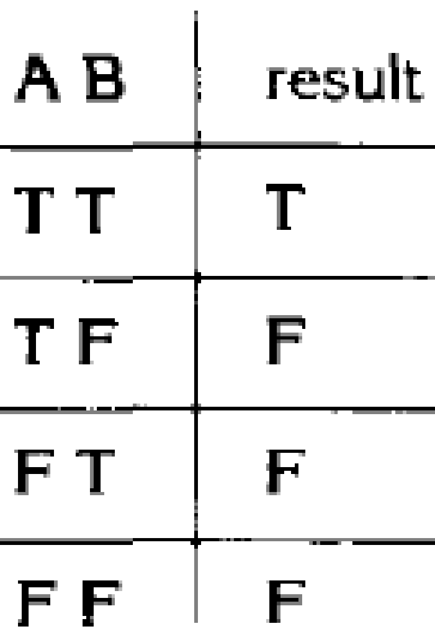
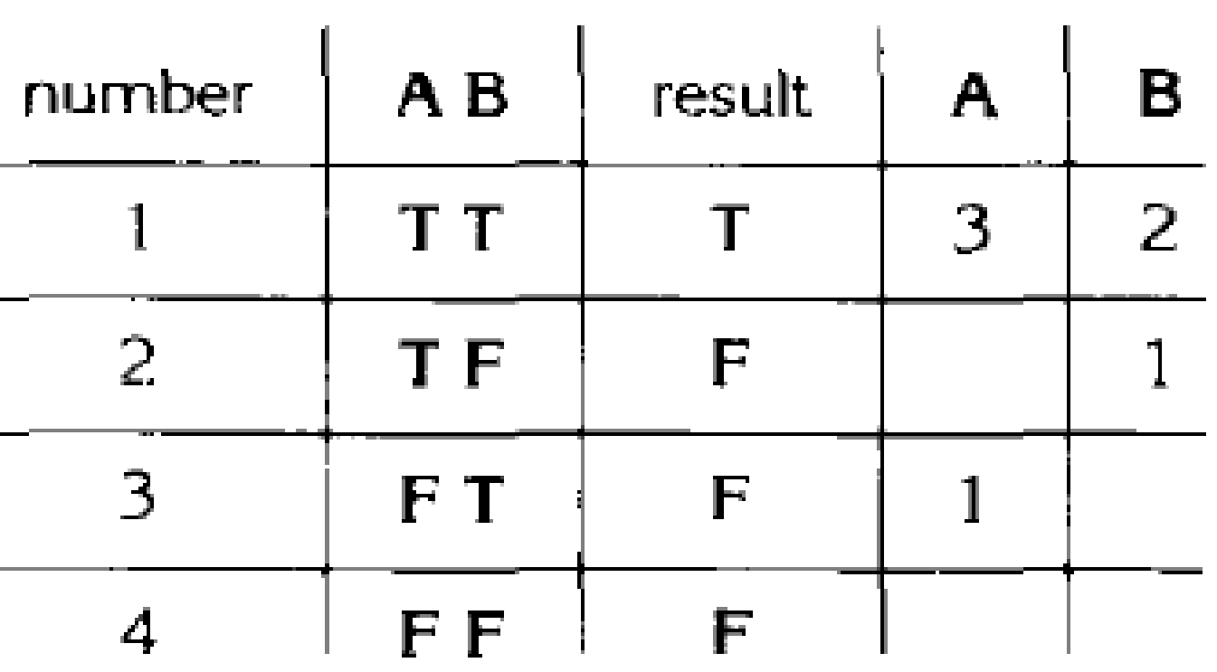
Creating MC/DC test cases
If (A and B) then…
(1) create truth table for conditions.
(2) Extend truth table so that it indicated which test cases can be used to show the independence of each condition.
Mar/Apr-2016
‹#›
Notes:
(T,T) test is required as it is the only one that returns true
(F,T) test is required as it is the only test that changes the value of only A and also changes the decision's outcome, thereby establishing the independence of A In similar fashion
(T,T) and (T,F) tests are required to show the independence of B.
Test set {(T,T), (T,F), (F,T)} satisfies MC/DC for the expression A and B.

Slide 83
Creating test cases cont’d
Show independence of A:
Take 1 + 3
Show independence of B:
Take 1 + 2
Resulting test cases are
1 + 2 + 3
(T , T) + (T , F) + (F , T)
Mar/Apr-2016
‹#›

Slide 84
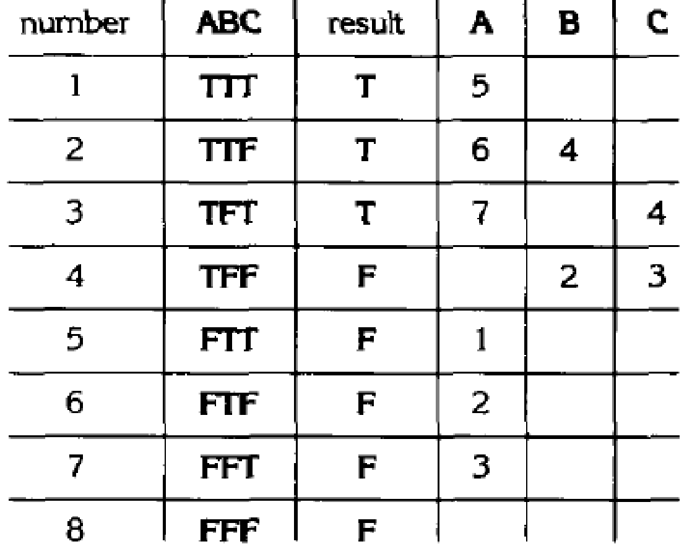
More advanced example
If (A and (B or C)) then…
Note: We want to determine the MINIMAL set of test cases
Here:
{2,3,4,6}
{2,3,4,7}
Non-minimal set is:
{1,2,3,4,5}
Mar/Apr-2016
‹#›

Slide 85
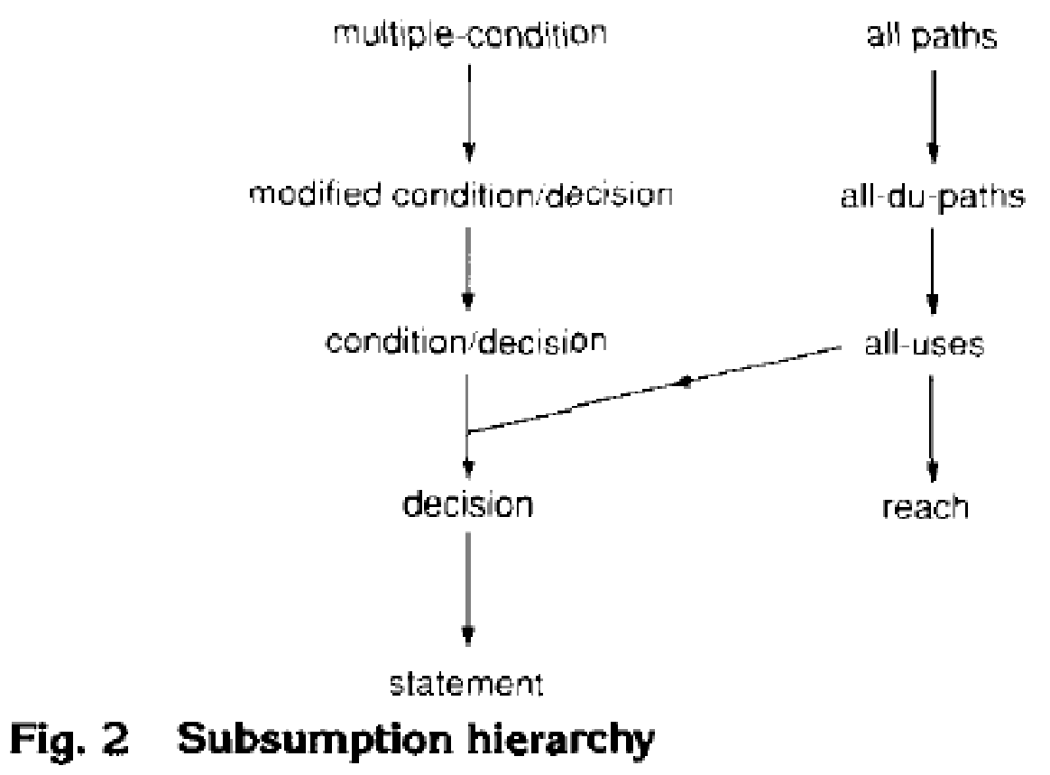
Where does it fit in?
The MC/DC criterion is stronger than the condition/decision coverage criterion,
but the number of test cases to achieve the MC/DC criterions still varies linearly with the number of conditions n in the decisions.
Much more complete coverage than condition/decision coverage,
At the same time it is not terribly costly in terms of number of test cases.
Mar/Apr-2016
‹#›

Slide 86
Path Coverage
Design test cases such that:
All linearly independent paths in the program are executed at least once.
Defined in terms of
Control flow graph (CFG) of a program.
Mar/Apr-2016
‹#›

Slide 87
Path Coverage-Based Testing
To understand the path coverage-based testing:
we need to learn how to draw control flow graph of a program.
A control flow graph (CFG) describes:
The sequence in which different instructions of a program get executed.
The way control flows through the program.
Mar/Apr-2016
‹#›

Slide 88
How to Draw Control Flow Graph?
Number all statements of a program.
Numbered statements:
Represent nodes of control flow graph.
An edge from one node to another node exists:
If execution of the statement representing the first node
Can result in transfer of control to the other node.
Mar/Apr-2016
‹#›

Slide 89
Example
int f1(int x,int y){
1 while (x != y){
2 if (x>y) then
3 x=x-y;
4 else y=y-x;
5 }
6 return x; }
Mar/Apr-2016
‹#›

Slide 90
Example Control Flow Graph
1
2
3
4
5
6
Mar/Apr-2016
‹#›

Slide 91
How to Draw Control flow Graph?
Sequence:
1 a=5;
2 b=a*b-1;
1
2
Mar/Apr-2016
‹#›

Slide 92
How to Draw Control Flow Graph?
Selection:
1 if(a>b) then
2 c=3;
3 else c=5;
4 c=c*c;
1
2
3
4
Mar/Apr-2016
‹#›

Slide 93
How to Draw Control Flow Graph?
Iteration:
1 while(a>b){
2 b=b*a;
3 b=b-1;}
4 c=b+d;
1
2
3
4
Mar/Apr-2016
‹#›

Slide 94
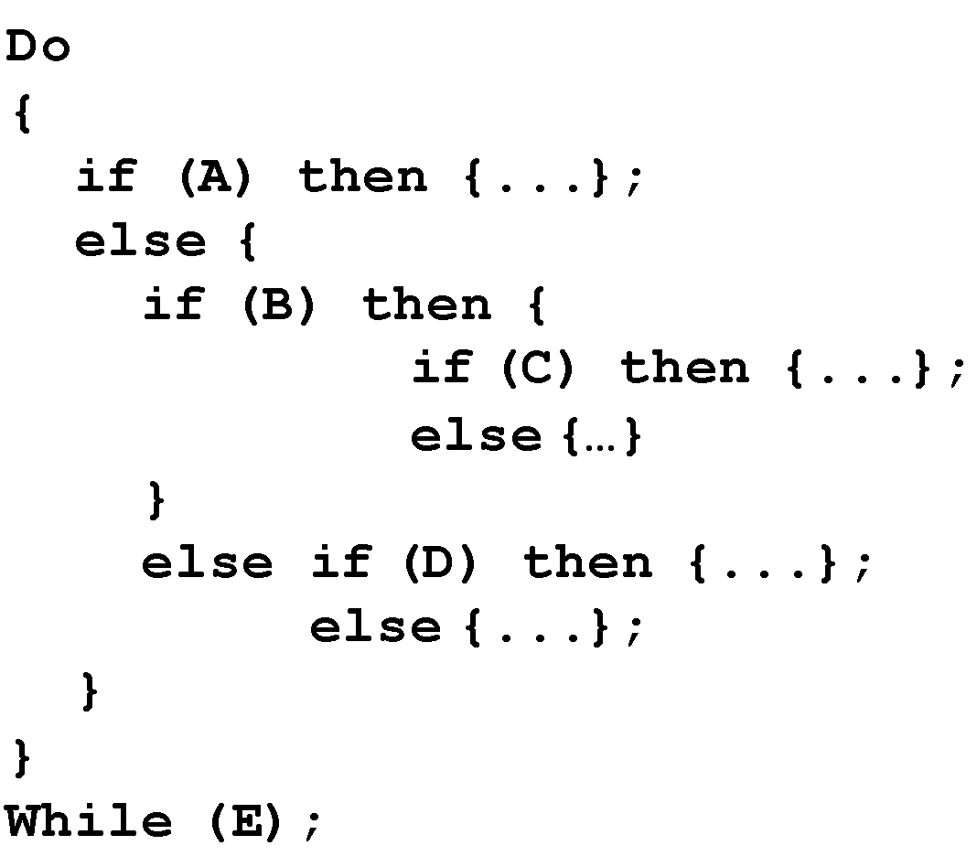
Example Code Fragment
Mar/Apr-2016
‹#›

Slide 95
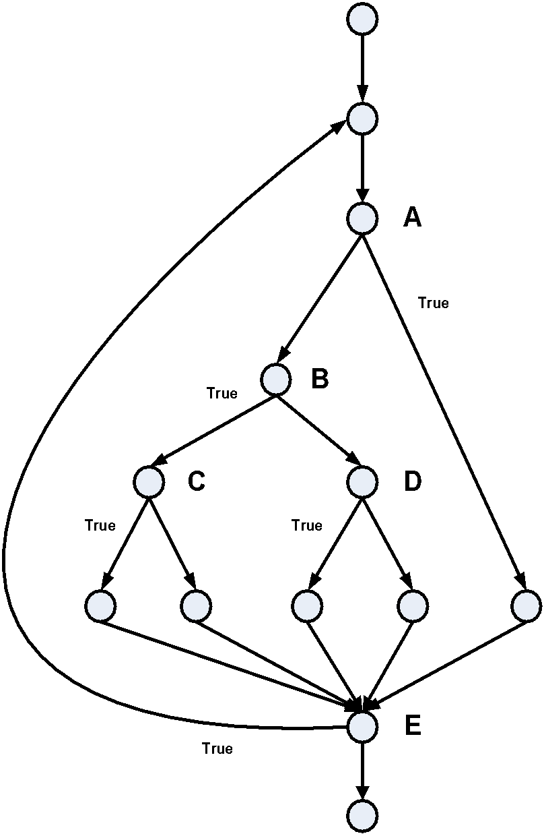
Example Control Flow Graph
Mar/Apr-2016
‹#›
Source: The Art of Software Testing – Glenford Myers

Slide 96
Path
A path through a program:
A node and edge sequence from the starting node to a terminal node of the control flow graph.
There may be several terminal nodes for program.
Mar/Apr-2016
‹#›

Slide 97
Linearly Independent Path
Any path through the program:
Introduces at least one new edge:
Not included in any other independent paths.
Mar/Apr-2016
‹#›

Slide 98
Independent path
It is straight forward:
To identify linearly independent paths of simple programs.
For complicated programs:
It is not easy to determine the number of independent paths.
Mar/Apr-2016
‹#›

Slide 99
McCabe's Cyclomatic Metric
An upper bound:
For the number of linearly independent paths of a program
Provides a practical way of determining:
The maximum number of linearly independent paths in a program.
Mar/Apr-2016
‹#›

Slide 100
McCabe's Cyclomatic Metric
Given a control flow graph G, cyclomatic complexity V(G):
V(G)= E-N+2
N is the number of nodes in G
E is the number of edges in G
Mar/Apr-2016
‹#›

Slide 101
Example Control Flow Graph
1
Cyclomatic complexity = 7-6+2 = 3.
2
3
4
5
6
Mar/Apr-2016
‹#›

Slide 102
Cyclomatic Complexity
Another way of computing cyclomatic complexity:
inspect control flow graph
determine number of bounded areas in the graph
V(G) = Total number of bounded areas + 1
Any region enclosed by a nodes and edge sequence.
Mar/Apr-2016
‹#›

Slide 103
Example Control Flow Graph
1
2
3
4
5
6
Mar/Apr-2016
‹#›

Slide 104
Example
From a visual examination of the CFG:
Number of bounded areas is 2.
Cyclomatic complexity = 2+1=3.
Mar/Apr-2016
‹#›

Slide 105
Cyclomatic Complexity
McCabe's metric provides:
A quantitative measure of testing difficulty and the ultimate reliability
Intuitively,
Number of bounded areas increases with the number of decision nodes and loops.
Mar/Apr-2016
‹#›

Slide 106
Cyclomatic Complexity
The first method of computing V(G) is amenable to automation:
You can write a program which determines the number of nodes and edges of a graph
Applies the formula to find V(G).
Mar/Apr-2016
‹#›

Slide 107
Cyclomatic Complexity
The cyclomatic complexity of a program provides:
A lower bound on the number of test cases to be designed
To guarantee coverage of all linearly independent paths.
Mar/Apr-2016
‹#›

Slide 108
Cyclomatic Complexity
A measure of the number of independent paths in a program.
Provides a lower bound:
for the number of test cases for path coverage.
Mar/Apr-2016
‹#›

Slide 109
Cyclomatic Complexity
Knowing the number of test cases required:
Does not make it any easier to derive the test cases,
Only gives an indication of the minimum number of test cases required.
Mar/Apr-2016
‹#›

Slide 110
Practical Path Testing
The tester proposes initial set of test data :
Using his experience and judgement.
A dynamic program analyzer used:
Measures which parts of the program have been tested
Result used to determine when to stop testing.
Mar/Apr-2016
‹#›

Slide 111
Derivation of Test Cases
Draw control flow graph.
Determine V(G).
Determine the set of linearly independent paths.
Prepare test cases:
to force execution along each path.
Mar/Apr-2016
‹#›

Slide 112
Example
int f1(int x,int y){
1 while (x != y){
2 if (x>y) then
3 x=x-y;
4 else y=y-x;
5 }
6 return x; }
Mar/Apr-2016
‹#›

Slide 113
Example Control Flow Diagram
1
2
3
4
5
6
Mar/Apr-2016
‹#›

Slide 114
Derivation of Test Cases
Number of independent paths: 3
1,6 test case (x=1, y=1)
1,2,3,5,1,6 test case(x=1, y=2)
1,2,4,5,1,6 test case(x=2, y=1)
Mar/Apr-2016
‹#›

Slide 115
An Interesting Application of Cyclomatic Complexity
Relationship exists between:
McCabe's metric
The number of errors existing in the code,
The time required to find and correct the errors.
Mar/Apr-2016
‹#›

Slide 116
Cyclomatic Complexity
Cyclomatic complexity of a program:
Also indicates the psychological complexity of a program.
Difficulty level of understanding the program.
Mar/Apr-2016
‹#›

Slide 117
Cyclomatic Complexity
From maintenance perspective,
Limit cyclomatic complexity of modules
To some reasonable value.
Good software development organizations:
Restrict cyclomatic complexity of functions to a maximum of ten or so.
Mar/Apr-2016
‹#›

Slide 118
White-Box Testing : Summary
weakest
statement
coverage
condition
coverage
branch
(or decision)
coverage
branch and condition (or condition /decision) coverage
modified condition / decision coverage
independent path (or basis path)
coverage
multiple- condition
coverage
only if paths across composite conditions are distinguished
strongest
path
coverage
Mar/Apr-2016
‹#›

Slide 119
Mutation Testing
The software is first tested:
using an initial testing method based on white-box strategies we already discussed.
After the initial testing is complete,
mutation testing is taken up.
The idea behind mutation testing:
Make a few arbitrary small changes to a program at a time.
Mar/Apr-2016
‹#›

Slide 120
Main Idea
Insert faults into a program:
Check whether the tests pick them up
Either validate or invalidate the tests.
08/10/1003/08/10
Mar/Apr-2016
‹#›

Slide 121
Mutation Testing
Each time the program is changed,
it is called a mutated program
the change is called a mutant.
Mar/Apr-2016
‹#›

Slide 122
Mutation Testing
A mutated program:
Tested against the full test suite of the program.
If there exists at least one test case in the test suite for which:
A mutant gives an incorrect result,
Then the mutant is said to be dead.
Mar/Apr-2016
‹#›

Slide 123
Mutation Testing
If a mutant remains alive:
even after all test cases have been exhausted,
the test suite is enhanced to kill the mutant.
The process of generation and killing of mutants:
can be automated by predefining a set of primitive changes that can be applied to the program.
Mar/Apr-2016
‹#›

Slide 124
Mutation Testing
The primitive changes can be:
Deleting a statement
Altering an arithmetic operator,
Changing the value of a constant,
Changing a data type, etc.
Mar/Apr-2016
‹#›

Slide 125
Data Flow-Based Testing
Selects test paths of a program:
According to the locations of
Definitions and uses of different variables in a program.
Mar/Apr-2016
‹#›

Slide 126
Data Flow-Based Testing
For a statement numbered S,
DEF(S) = {X/statement S contains a definition of X}
USES(S)= {X/statement S contains a use of X}
Example: 1: a=b; DEF(1)={a}, USES(1)={b}.
Example: 2: a=a+b; DEF(2)={a}, USES(2)={a,b}.
Mar/Apr-2016
‹#›

Slide 127
Data Flow-Based Testing
A variable X is said to be live at statement S1, if
X is defined at a statement S:
There exists a path from S to S1 not containing any definition of X.
Mar/Apr-2016
‹#›

Slide 128
DU Chain Example
1 X(){
2 a=5; /* Defines variable a */
3 While(C1) {
4 if (C2)
5 b=a*a; /*Uses variable a */
6 a=a-1; /* Defines variable a */
7 }
8 print(a); } /*Uses variable a */
Mar/Apr-2016
‹#›

Slide 129
Definition-use chain (DU chain)
[X,S,S1],
S and S1 are statement numbers,
X in DEF(S)
X in USES(S1), and
the definition of X in the statement S is live at statement S1.
Mar/Apr-2016
‹#›

Slide 130
Data Flow-Based Testing
One simple data flow testing strategy:
Every DU chain in a program be covered at least once.
Data flow testing strategies:
Useful for selecting test paths of a program containing nested if and loop statements.
Mar/Apr-2016
‹#›

Slide 131
Data Flow-Based Testing
1 X(){
2 B1; /* Defines variable a */
3 While(C1) {
4 if (C2)
5 if(C4) B4; /*Uses variable a */
6 else B5;
7 else if (C3) B2;
8 else B3; }
9 B6 }
Mar/Apr-2016
‹#›

Slide 132
Data Flow-Based Testing
[a,1,5]: a DU chain.
Assume:
DEF(X) = {B1, B2, B3, B4, B5}
USED(X) = {B2, B3, B4, B5, B6}
There are 25 DU chains.
However only 5 paths are needed to cover these chains.
Mar/Apr-2016
‹#›

Slide 133
DEBUGGING
Mar/Apr-2016
‹#›

Slide 134
Debugging
Once errors are identified:
It is necessary identify the precise location of the errors and to fix them.
Each debugging approach has its advantages and disadvantages:
Each is useful in appropriate circumstances.
Mar/Apr-2016
‹#›

Slide 135
Brute-Force Method
This is the most common method of debugging:
Least efficient method.
Program is loaded with print statements
Print the intermediate values
Hope that some of printed values will help identify the error.
Mar/Apr-2016
‹#›

Slide 136
Symbolic Debugger
More systematic than Brute force method:
Symbolic debuggers get their name for historical reasons
Early debuggers let you only see values from a program dump:
Determine which variable it corresponds to.
Mar/Apr-2016
‹#›

Slide 137
Symbolic Debugger
Using a symbolic debugger:
Values of different variables can be easily checked and modified
Single stepping to execute one instruction at a time
Break points and watch points can be set to test the values of variables.
Mar/Apr-2016
‹#›

Slide 138
Backtracking
This is a fairly common approach.
Beginning at the statement where an error symptom has been observed:
Source code is traced backwards until the error is discovered.
Mar/Apr-2016
‹#›

Slide 139
Example
int main(){ int i,j,s;
i=1;
while(i<=10){ s=s+i; i++; j=j++;}
printf(“%d”,s);
}
Mar/Apr-2016
‹#›

Slide 140
Backtracking
Unfortunately, as the number of source lines to be traced back increases,
The number of potential backward paths increases
Becomes unmanageably large for complex programs.
Mar/Apr-2016
‹#›

Slide 141
Cause-Elimination Method
Determine a list of causes:
which could possibly have contributed to the error symptom.
tests are conducted to eliminate each.
A related technique of identifying error by examining error symptoms:
software fault tree analysis.
Mar/Apr-2016
‹#›

Slide 142
Program Slicing
This technique is similar to back tracking.
However, the search space is reduced by defining slices.
A slice is defined for a particular variable at a particular statement:
set of source lines preceding this statement which can influence the value of the variable.
Mar/Apr-2016
‹#›

Slide 143
Example
int main(){ int i,s;
i=1; s=1;
while(i<=10){ s=s+i; i++;}
printf(“%d”,s);
printf(“%d”,i);
}
Mar/Apr-2016
‹#›

Slide 144
Debugging Guidelines
Debugging requires a thorough understanding of program design.
Debugging may sometimes require full redesign of the system.
A common mistake novice programmers often make:
Not fixing the error but the error symptoms.
Mar/Apr-2016
‹#›

Slide 145
Debugging Guidelines
Be aware of the possibility:
An error correction may introduce new errors.
After every round of error-fixing:
Regression testing must be carried out.
Mar/Apr-2016
‹#›

Slide 146
TOOLS
Mar/Apr-2016
‹#›

Slide 147
Program Analysis Tools
An automated tool:
takes program source code as input
produces reports regarding several important characteristics of the program,
such as size, complexity, adequacy of commenting, adherence to programming standards, etc.
Mar/Apr-2016
‹#›

Slide 148
Program Analysis Tools
Some program analysis tools:
Produce reports regarding the adequacy of the test cases.
There are essentially two categories of program analysis tools:
Static analysis tools
Dynamic analysis tools
Mar/Apr-2016
‹#›

Slide 149
Static Analysis Tools
Static analysis tools:
Assess properties of a program without executing it.
Analyze the source code
Provide analytical conclusions.
Mar/Apr-2016
‹#›

Slide 150
Static Analysis Tools
Whether coding standards have been adhered to?
Commenting is adequate?
Programming errors such as:
Uninitialized variables
Mismatch between actual and formal parameters.
Variables declared but never used, etc.
Mar/Apr-2016
‹#›

Slide 151
Static Analysis Tools
Code walk through and inspection can also be considered as static analysis methods:
However, the term static program analysis is generally used for automated analysis tools.
Mar/Apr-2016
‹#›

Slide 152
Dynamic Analysis Tools
Dynamic program analysis tools require the program to be executed:
its behavior recorded.
Produce reports such as adequacy of test cases.
Mar/Apr-2016
‹#›

Slide 153
Memory Checker Tools
Tool | Source | OS | Type | Instrumentation
Purify | IBM (Rational) | Unix, Windows | Dynamic | Source
Insure++ | Parasoft | Unix, Windows | Dynamic | Source
BoundsChecker (DevPartner) | Micro Focus (nuMega) | Windows (MS-VC) | Dynamic | Source
Valgrind | Open Source | Linux, Mac, Android | Dynamic | Binary
Mar/Apr-2016
‹#›

Slide 154
Tool Links
Purify: http://www-01.ibm.com/software/awdtools/purify/
Insure++: http://www.parasoft.com/jsp/products/insure.jsp;jsessionid=baa_7OL5TFb-Ty?itemId=63
BoundsChecker: http://www.microfocus.com/products/micro-focus-developer/devpartner/index.aspx
Valgrind: http://valgrind.org/
Mar/Apr-2016
‹#›

Slide 155
Coverage Tools
Tool | Source | OS | Type | Instrumentation
Purecov | IBM (Rational) | Unix, Windows | Dynamic | Source
Code Coverage Unit | Parasoft | Unix, Windows | Dynamic | Source
TrueCoverage (DevPartner) | Micro Focus (nuMega) | Windows (MS-VC) | Dynamic | Source
gcov / lcov | Open Source (GCC) | Linux, Windows | Dynamic | Source
Mar/Apr-2016
‹#›

Slide 156
Tool Links
Purecov: ftp://ftp.software.ibm.com/software/rational/docs/v2003/purecov/html/ht_intro_pc.htm
Code Coverage Unit of Parasoft: http://www.parasoft.com/jsp/capabilities/coverage_analysis.jsp
TrueCoverage: http://www.microfocus.com/products/micro-focus-developer/devpartner/index.aspx
gcov: http://gcc.gnu.org/onlinedocs/gcc/Gcov-Intro.html#Gcov-Intro
lcov: http://ltp.sourceforge.net/coverage/lcov.php
Mar/Apr-2016
‹#›

Slide 157
Performance / Profiling Tools
Tool | Source | OS | Type | Instrumentation
Quatify | IBM (Rational) | Unix, Windows | Dynamic | Source
VTune | Intel | Unix, Windows | Dynamic | Source, Binary
TrueTime (DevPartner) | Micro Focus (nuMega) | Windows (MS-VC) | Dynamic | Source
gprof | Open Source | Linux, | Dynamic | Binary
Mar/Apr-2016
‹#›

Slide 158
Tool Links
Quatify: http://h21007.www2.hp.com/portal/site/dspp/menuitem.863c3e4cbcdc3f3515b49c108973a801?ciid=83080055abe021100055abe02110275d6e10RCRD
TrueTime: http://www.microfocus.com/products/micro-focus-developer/devpartner/index.aspx
gprof: http://www.cs.utah.edu/dept/old/texinfo/as/gprof.html
Vtune: http://software.intel.com/en-us/articles/intel-vtune-amplifier-xe/
Mar/Apr-2016
‹#›

Slide 159
Code Analysis Tools
Tool | Source | OS | Type | Instrumentation
GCC | Open Source (GNU) | Unix, Windows | Static | Source
C/C++ Test | Parasoft | Unix, Windows | Static, Dynamic | Source
Mar/Apr-2016
‹#›

Slide 160
Tool Links
GCC: http://gcc.gnu.org/
C/C++ Test: http://www.parasoft.com/jsp/products/cpptest.jsp?itemId=47
Mar/Apr-2016
‹#›

Slide 161
GUI Test Tools
Tool | Source | OS | Type | Instrumentation
Selenium | Open Source [ThoughtWorks] | Unix, Windows | Record & Playback | None
WinRunner | RPM Solutions | Unix, Windows | Record & Playback | None
Mar/Apr-2016
‹#›

Slide 162
Tool Links
Selenium: http://en.wikipedia.org/wiki/Selenium_(software)
WinRunner: http://www.loadtest.com.au/Technology/winrunner.htm
Mar/Apr-2016
‹#›

Slide 163
Tool Builder Tools
Tool | Source | OS | Type | Instrumentation
PIN | Freeware (Intel) | Unix, Windows, Mac | Dynamic | Binary
LLVM | Open Source | Unix, Windows | Static | Source
Mar/Apr-2016
‹#›

Slide 164
Tool Links
Pin: http://www.pintool.org/
LLVM: http://llvm.org/
Mar/Apr-2016
‹#›

Slide 165
TESTING FOR SYSTEM DEVELOPMENT
Mar/Apr-2016
‹#›

Slide 166
Testing
The aim of testing is to identify all defects in a software product.
However, in practice even after thorough testing:
One cannot guarantee that the software is error-free.
Mar/Apr-2016
‹#›

Slide 167
Testing
The input data domain of most software products is very large:
It is not practical to test the software exhaustively with each input data value.
Mar/Apr-2016
‹#›

Slide 168
Testing
Testing however exposes many errors:
Testing provides a practical way of reducing defects in a system
Increases the users' confidence in the system.
Mar/Apr-2016
‹#›

Slide 169
Testing
Software products are tested at three levels:
Unit testing
Integration testing
System testing
Mar/Apr-2016
‹#›

Slide 170
Unit testing
During unit testing, modules are tested in isolation:
If all modules were to be tested together:
It may not be easy to determine which module has the error.
Mar/Apr-2016
‹#›

Slide 171
Unit testing
Unit testing reduces debugging effort several folds.
Programmers carry out unit testing immediately after they complete the coding of a module.
Mar/Apr-2016
‹#›

Slide 172
Unit testing
Unit testing drives development in Test-Driven Development (TDD)
http://www.agiledata.org/essays/tdd.html
Mar/Apr-2016
‹#›

Slide 173
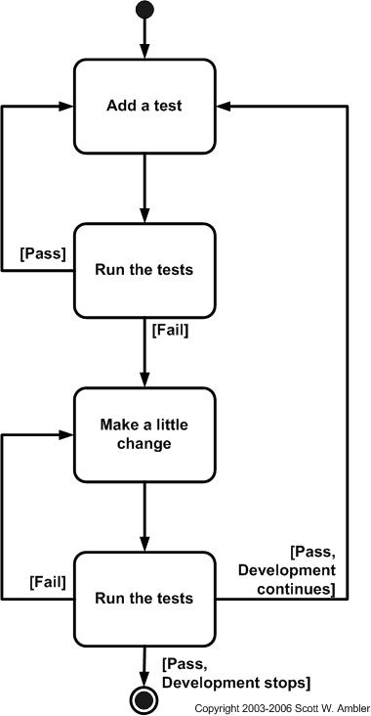
TDD
Mar/Apr-2016
‹#›

Slide 174
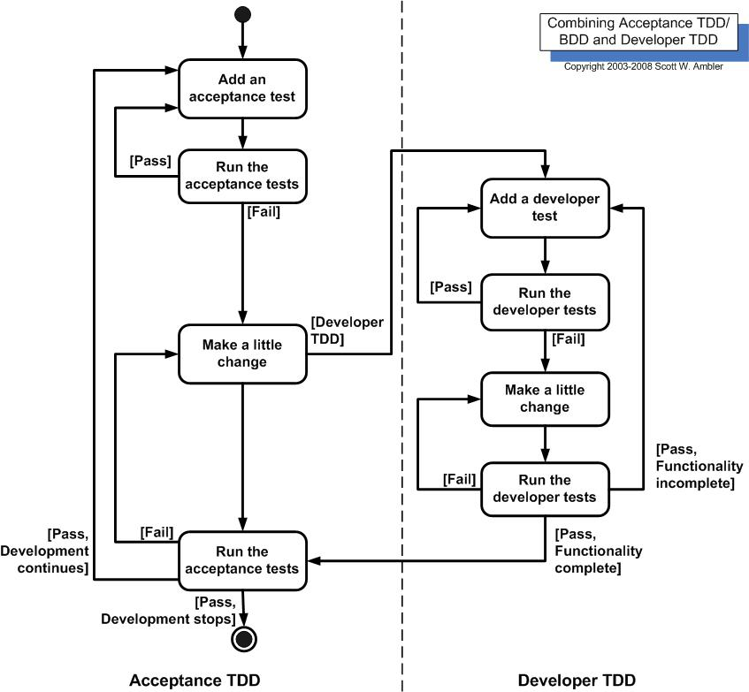
TDD
Mar/Apr-2016
‹#›

Slide 175
Unit testing
For a class attach a (test) unit (typically JUnit in Java or CPPUnit in C++)) that tests the class
Mar/Apr-2016
‹#›

Slide 176
Unit testing
D Language:(http://dlang.org/overview.html) provides specific support for unit testing.
Unit testing is a main feature of D
Mar/Apr-2016
‹#›

Slide 177
Unit testing in D
Unit tests can be added to a class - they are run upon program start-up.
Aids in verifying that class implementations weren't inadvertently broken.
Unit tests is a part of the code for a class.
Creating tests is a part of the development process
Mar/Apr-2016
‹#›

Slide 178
Integration testing
After different modules of a system have been coded and unit tested:
modules are integrated in steps according to an integration plan
partially integrated system is tested at each integration step.
Mar/Apr-2016
‹#›

Slide 179
System Testing
Objective:
Validate a fully developed system against its requirements.
Mar/Apr-2016
‹#›

Slide 180
Integration Testing
Develop the integration plan by examining the structure chart :
big bang approach
top-down approach
bottom-up approach
mixed approach
Mar/Apr-2016
‹#›

Slide 181
Example Structured Design
root
Valid-numbers
rms
rms
Valid-numbers
Get-good-data
Compute-solution
Display-solution
Get-data
Validate-data
Mar/Apr-2016
‹#›

Slide 182
Big Bang Integration Testing
Big bang approach is the simplest integration testing approach:
all the modules are simply put together and tested.
this technique is used only for very small systems.
Mar/Apr-2016
‹#›

Slide 183
Big Bang Integration Testing
Main problems with this approach:
If an error is found:
It is very difficult to localize the error
The error may potentially belong to any of the modules being integrated.
Debugging errors found during big bang integration testing are very expensive to fix.
Mar/Apr-2016
‹#›

Slide 184
Bottom-up Integration Testing
Integrate and test the bottom level modules first.
A disadvantage of bottom-up testing:
when the system is made up of a large number of small subsystems.
This extreme case corresponds to the big bang approach.
Mar/Apr-2016
‹#›

Slide 185
Top-down Integration Testing
Top-down integration testing starts with the main routine:
and one or two subordinate routines in the system.
After the top-level 'skeleton’ has been tested:
immediate subordinate modules of the 'skeleton’ are combined with it and tested.
Mar/Apr-2016
‹#›

Slide 186
Mixed Integration Testing
Mixed (or sandwiched) integration testing:
Uses both top-down and bottom-up testing approaches.
Most common approach
Mar/Apr-2016
‹#›

Slide 187
Integration Testing
In top-down approach:
testing waits till all top-level modules are coded and unit tested.
In bottom-up approach:
testing can start only after bottom level modules are ready.
Mar/Apr-2016
‹#›

Slide 188
System Testing
System tests are designed to validate a fully developed system:
To assure that it meets its requirements.
Mar/Apr-2016
‹#›

Slide 189
System Testing
There are three main kinds of system testing:
Alpha Testing
Beta Testing
Acceptance Testing
Mar/Apr-2016
‹#›

Slide 190
System Releases
These 3 kinds relate to 3 types of releases:
Alpha Release
Beta Release
FCS
Mar/Apr-2016
‹#›

Slide 191
Alpha Release
All functionality has been implemented
Reasonable testing has been done by internal (developer / tester) teams
No preview expected from ‘real’ users yet.
Mar/Apr-2016
‹#›

Slide 192
Beta Release
All functionality has been thoroughly tested
Releases made to friendly customers (or non-developer internal groups). Or beta programs launched
Must include ‘real’ users of a system
Mar/Apr-2016
‹#›

Slide 193
FCS Release
FCS – First Customer Shipment
Company has gained fair confidence on the quality
Customer will use this release now till (Minor) bug fix releases are done or new (Major) version is produced
Mar/Apr-2016
‹#›

Slide 194
Alpha Testing
Performed on Alpha Release
System testing is carried out by the test team within the developing organization.
Mar/Apr-2016
‹#›

Slide 195
Beta Testing
Performed on Beta Release
System testing performed by a select group of friendly customers.
Mar/Apr-2016
‹#›

Slide 196
Acceptance Testing
Performed on FCS
System testing performed by the customer himself:
To determine whether the system should be accepted or rejected.
Mar/Apr-2016
‹#›

Slide 197
System Testing
During system testing:
Functional requirements are validated through functional tests.
Non-functional requirements validated through performance tests.
Mar/Apr-2016
‹#›

Slide 198
Performance Testing
Addresses non-functional requirements.
May sometimes involve testing hardware and software together.
There are several categories of performance testing.
Typical performances are:
Time
Peak Memory
Average Memory
Mar/Apr-2016
‹#›

Slide 199
Stress testing
Evaluates system performance
when stressed for short periods of time.
Stress testing
also known as endurance testing.
Mar/Apr-2016
‹#›

Slide 200
Stress testing
Stress tests are black box tests:
Designed to impose a range of abnormal and even illegal input conditions
So as to stress the capabilities of the software.
Often stress tests test for the endurance of the internal data structures (like size of a stack)
Mar/Apr-2016
‹#›

Slide 201
Stress Testing
If the requirements is to handle a specified number of users, or devices:
Stress testing evaluates system performance when all users or devices are busy simultaneously.
Mar/Apr-2016
‹#›

Slide 202
Stress Testing
If an operating system is supposed to support 15 multiprogrammed jobs,
The system is stressed by attempting to run 15 or more jobs simultaneously.
A real-time system might be tested
To determine the effect of simultaneous arrival of several high-priority interrupts.
Mar/Apr-2016
‹#›

Slide 203
Stress Testing
Stress testing usually involves an element of time or size,
Such as the number of records transferred per unit time,
The maximum number of users active at any time, input data size, etc.
Therefore stress testing may not be applicable to many types of systems.
Mar/Apr-2016
‹#›

Slide 204
Volume Testing
Addresses handling large amounts of data in the system:
Whether data structures (e.g. queues, stacks, arrays, etc.) are large enough to handle all possible situations.
Fields, records, and files are stressed to check if their size can accommodate all possible data volumes.
Mar/Apr-2016
‹#›

Slide 205
Configuration Testing
Analyze system behavior:
in various hardware and software configurations specified in the requirements
sometimes systems are built in various configurations for different users
for instance, a minimal system may serve a single user,
other configurations for additional users.
Mar/Apr-2016
‹#›

Slide 206
Compatibility Testing
These tests are needed when the system interfaces with other systems:
Check whether the interface functions as required.
For example, if a 32-bit release works on a 64-bit platform
Mar/Apr-2016
‹#›

Slide 207
Compatibility testing Example
If a system is to communicate with a large database system to retrieve information:
A compatibility test examines speed and accuracy of retrieval.
Mar/Apr-2016
‹#›

Slide 208
Recovery Testing
These tests check response to:
Presence of faults or to the loss of data, power, devices, or services
Subject system to loss of resources
Check if the system recovers properly.
For example, a net payment fails after the payer has been debited and before the payee has been credited
Mar/Apr-2016
‹#›

Slide 209
Maintenance Testing
Diagnostic tools and procedures:
help find source of problems.
It may be required to supply
memory maps
diagnostic programs
traces of transactions,
circuit diagrams, etc.
Mar/Apr-2016
‹#›

Slide 210
Maintenance Testing
Verify that:
all required artefacts for maintenance exist
they function properly
For example, if MS Office crashes it asks for sending some system information to MS. These are meant for remote debugging and fix
Mar/Apr-2016
‹#›

Slide 211
Documentation tests
Check that required documents exist and are consistent:
user guides,
maintenance guides,
technical documents
Mar/Apr-2016
‹#›

Slide 212
Documentation tests
Sometimes requirements specify:
Format and audience of specific documents
Documents are evaluated for compliance
Mar/Apr-2016
‹#›

Slide 213
Documentation tests
Keeping documents in sync with the code changes is a major challenge. Documentation Tests must ascertain such gaps.
It is advised to use in-code documentation to generate help on the fly using:
Doxygen: http://www.stack.nl/~dimitri/doxygen/
Javadoc: http://www.oracle.com/technetwork/java/javase/documentation/index-jsp-135444.html
Mar/Apr-2016
‹#›

Slide 214
Usability tests
All aspects of user interfaces are tested:
Display screens
messages
report formats
navigation and selection problems
Mar/Apr-2016
‹#›

Slide 215
Environmental test
These tests check the system’s ability to perform at the installation site.
Requirements might include tolerance for
heat
humidity
chemical presence
portability
electrical or magnetic fields
disruption of power, etc.
Mar/Apr-2016
‹#›

Slide 216
Test Summary Report
Generated towards the end of testing phase.
Covers each subsystem:
A summary of tests which have been applied to the subsystem.
Mar/Apr-2016
‹#›

Slide 217
Test Summary Report
Specifies:
how many tests have been applied to a subsystem,
how many tests have been successful,
how many have been unsuccessful, and the degree to which they have been unsuccessful,
e.g. whether a test was an outright failure
or whether some expected results of the test were actually observed.
Mar/Apr-2016
‹#›

Slide 218
Regression Testing
Does not belong to either unit test, integration test, or system test.
In stead, it is a separate dimension to these three forms of testing.
Mar/Apr-2016
‹#›

Slide 219
Regression testing
Regression testing is the running of test suite:
after each change to the system after each bug fix.
Ensures that no new bug has been introduced due to the change or the bug fix.
Mar/Apr-2016
‹#›

Slide 220
Regression testing
Regression tests assure:
the new system’s performance is at least as good as the old system.
Always used during incremental system development.
Mar/Apr-2016
‹#›

Slide 221
How Many Errors are Still Remaining?
Seed the code with some known errors:
artificial errors are introduced into the program.
Check how many of the seeded errors are detected during testing.
Mar/Apr-2016
‹#›

Slide 222
Error Seeding
Let:
N be the total number of errors in the system
n of these errors be found by testing.
S be the total number of seeded errors,
s of the seeded errors be found during testing.
Mar/Apr-2016
‹#›

Slide 223
Error Seeding
n/N = s/S
N = S n/s
remaining defects: N - n = n ((S - s)/ s)
Mar/Apr-2016
‹#›

Slide 224
Example
100 errors were introduced.
90 of these errors were found during testing
50 other errors were also found.
Remaining errors= 50 (100-90)/90 = 6
Mar/Apr-2016
‹#›

Slide 225
Error Seeding
The kind of seeded errors should match closely with existing errors:
However, it is difficult to predict the types of errors that exist.
Categories of remaining errors:
can be estimated by analyzing historical data from similar projects.
Mar/Apr-2016
‹#›

Slide 226
Summary
Exhaustive testing of almost any non-trivial system is impractical.
we need to design an optimal test suite that would expose as many errors as possible.
Mar/Apr-2016
‹#›

Slide 227
Summary
If we select test cases randomly:
Many test cases may not add to the significance of the test suite.
There are two approaches to testing:
black-box testing
white-box testing.
Mar/Apr-2016
‹#›

Slide 228
Summary
Black box testing is also known as functional testing.
Designing black box test cases:
Requires understanding only SRS document
Does not require any knowledge about design and code.
Designing white box testing requires knowledge about design and code.
Mar/Apr-2016
‹#›

Slide 229
Summary
We discussed black-box test case design strategies:
Equivalence partitioning
Boundary value analysis
We discussed some important issues in integration and system testing.
Mar/Apr-2016
‹#›

